Slide 1
INAC Services Portal
Completing the Annual Register of Post-Secondary Education Students Report Online
(Recipients)

Slide 2
Learning Objectives
This presentation outlines the steps required to complete an Annual Register of Post-Secondary Education Students (PSE) Report online.
INAC requires that Recipients of funding under the Post-Secondary Student Support Program (PSSSP) and University and College Entrance Preparation (UCEP) Program provide reports on students who were eligible for PSE funding.

Slide 3
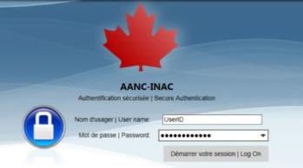
Logging onto the INAC Services Portal
In your browser, enter the following URL:
https://services.aadnc-aandc.gc.ca/iap
The INAC Secure Authentication page is displayed. Note that the URL address changes automatically to:
https://as-sa.aadnc-aandc.gc.ca/vpn/tmindex.html
Enter User name and Password and click Log On.
Important: Do NOT bookmark the INAC Secure Authentication page or add it to your favourites. After you log on, you can create a bookmark.

Slide 4
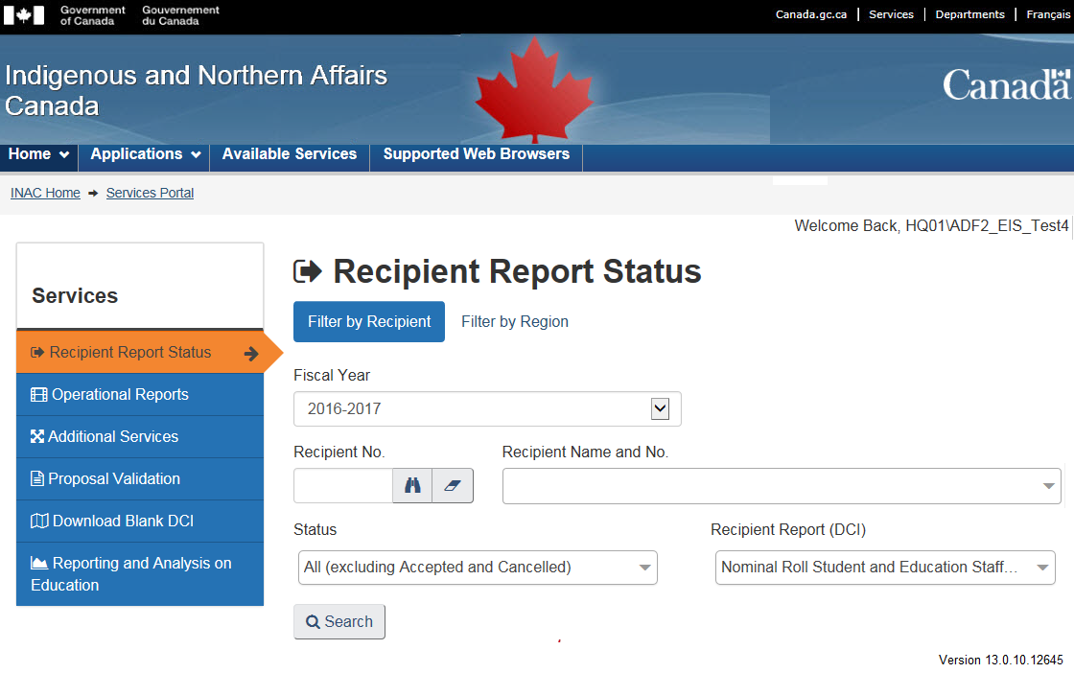
INAC Services Portal
The Portal includes the following elements:
Click on the Language button to toggle between English and French
Header
Menu Bar
User Name
Service Window
The Services Menu contains a list of actions the user can perform
Portal Version Number

Slide 5
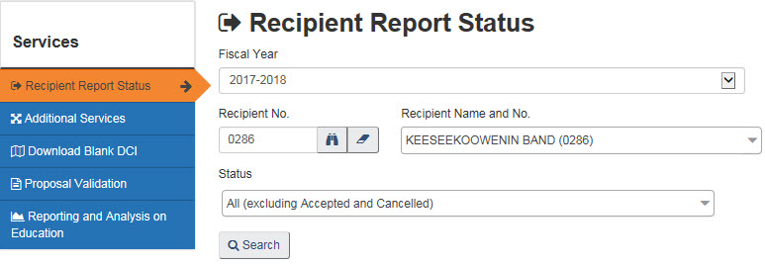
Locating Your PSE Report
Select the Recipient Report Status chevron.
Click Search to locate your reporting obligation.
Click the Create button.
Ensure that the following are selected:
Fiscal Year = Current Fiscal Year
Recipient = Your Organization
Status = All (excluding Accepted and Cancelled)
Click on the page numbers to navigate through the search results to locate the Annual Register of Post-Secondary Education Students Report.

Slide 6
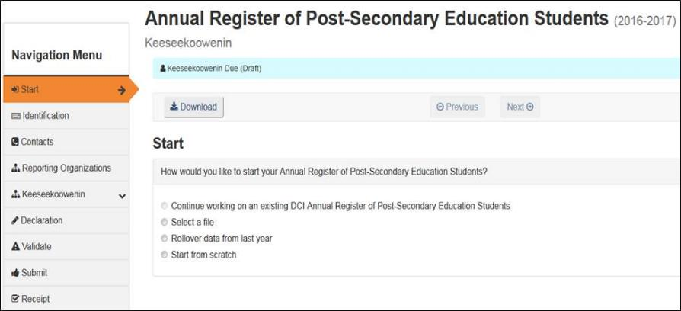
Start Options
On the Start chevron there are several options including:
Continue working on an existing DCI PSE Report – to continue working on the Report that you have started.
Select a file – to upload a PDF or XML file containing PSE Report information
Roll-over data from last year – to pre-fill many fields from last year’s Report including Institution and Student information, etc. This is the preferred option.
Note* : See slides 7 and 8 for more details on the Start Options.

Slide 7
Start Options (Roll-over Data from Last Year)
Choose the Roll-over data from last year option.
Click on the button. Wait for a few moments and the Identification screen is displayed (see Tip below).
Important: This is the preferred method. A significant amount of data is pre-filled for
you from last years’ Report! You will need to review the data and complete the data
fields including the expenses for each semester provided to each student. Delete the
students who are no longer enrolled in a post-secondary institution
Tip: There are several ways to navigate online:
Click on the button.
Click on a tab (e.g., ). The tab changes to an orange chevron (e.g., ) to indicate the tab is active and the information is displayed.
Click on a sub-tab (e.g., ) with a down arrow. More sub-tabs are displayed below.
Click on a sub-tab (e.g. ) and information is listed.

Slide 8
Upload a PDF or XML File
Choose the Select a file option.
Click on the button.
Click on the button.
You will automatically be directed to Windows Explorer on your system, from where you can select the file. Click Open. The file path will appear in the Browse field.
Click on the button.
Click on the button and the Identification ( ) chevron is displayed.

Slide 9
Important Information
Your data is automatically saved for you while working on the system. It ‘saves’ when you perform actions such as clicking on:
The and buttons
the Close button ( )
the tabs and chevrons in the Navigation Menu, etc.
A grey field means that it has been pre-filled and cannot be edited
A white field means that you can enter text.

Slide 10
Identification and Contacts
Click on the button or the chevron.
Make updates to the rolled-over information, if required.
Click on the chevron.
Verify the information in the Primary Contact section and make updates if required.
If a secondary contact has been identified, verify the information in the Secondary Contact section. If a secondary contact was not identified, and you would like to add one, click on the button.

Slide 11
PSE Sub-Reports
PSE Reports can now add Reporting Organizations (Sub-Reports)
There are two types of Reporting Organizations
Satellite Office (other) and
First Nation Chief and Council
Delivery Organizations (i.e., PSE Institutions) can be included on more than one Reporting Organization
Students can be included on different Reporting Organizations (for different semesters) but cannot be listed in two places for the same semester. An online validation will flag this situation.
Recipient (Organization ID) | Reporting Organization Types
First Nation Chief and Council | Satellite Office (other)
First Nation Education Authority | Satellite Office (other)
Regional First Nation Organization | Satellite Office (other) First Nation Chief and Council
Notes:
Note: Any of the splits that we already do, talk to Production Support and they will perform the splits.

Slide 12
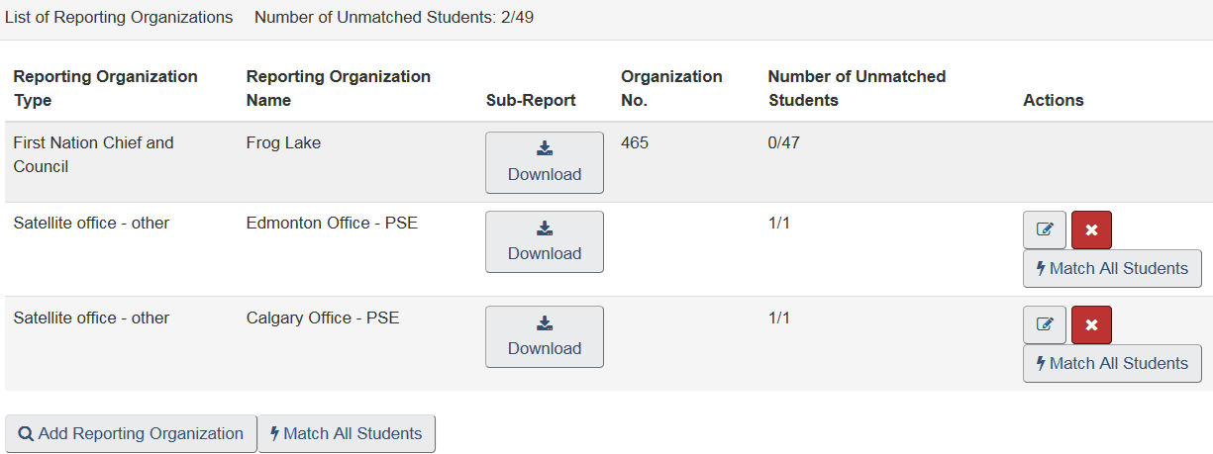
Reporting Organizations
Select the chevron. In this example, there are 3 Reporting Organizations. The first Reporting Organization in the list is always the Recipient.
To add a Reporting Organization click on the button. You will be attaching a separate PSE DCI or XML file.
On the Add Reporting Organization window, click .

Slide 13
Reporting Organizations
Copy the “Organization Name” (e.g. Calgary Office-PSE) from the DCI and paste in the Browse field.
Click on the button to locate the file on your computer.
Select the file and click Open.
Click on the button.
The Sub-Report file name appears under the Reporting Organization Name column to indicate that you have successfully attached it. The other fields are populated with data from the sub-report.

Slide 14
Delivery Organizations: Unfunded Students
Each Reporting Organization will have the option to provide information regarding eligible students who received partial or no PSSSP/UCEP funding (unfunded demand).
You will be asked the following question:
If you select Yes, you will need to complete the following two data fields
If you select No, the data fields will not be displayed

Slide 15
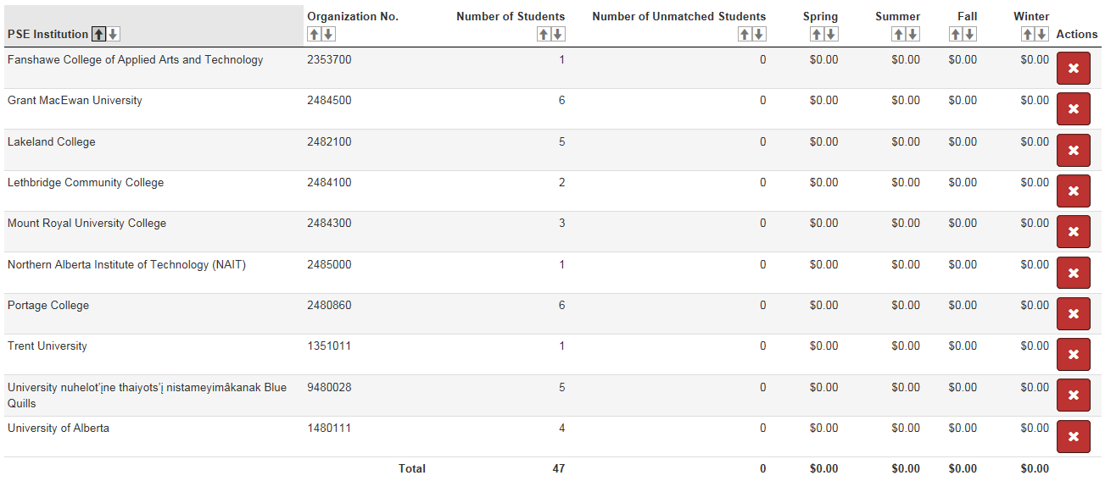
Delivery Organizations
Under each reporting organization will be the list of institutions that students were funded to attend.
An institution can be listed in more than one report.
The chevron displays the list of Post-Secondary Institutions and the number of students attended in the previous fiscal year. The amount spent for each semester is $0 as the student records need to be updated for this fiscal year.

Slide 16
Adding a Delivery Organization
Click to make a selection from a list of schools where students were accepted into a program of study and eligible for PSE funding.
A Search window will be displayed. Enter the name of the PSE Institution and click Search. A list of campuses will appear. If the institution is not on this list, contact your Regional Office.
Select the institution/campus you would like to add and the Institution No. data field is automatically populated.
Tip: To remove a PSE Institution, click and select OK to confirm. When you remove a PSE Institution, you also remove related Student Information.

Slide 17
Student Information: Adding a Student
Click the button in the top toolbar. Complete the Student Information section for students that applied to you and were eligible for PSE funding.
Enter the student’s Family Name, Given Name(s), Alias Name(s) (if applicable), Date of Birth, Gender and Identity.
Important: Only Inuit and registered First Nation students are eligible for PSSSP / UCEP funding. Refer to the National Program Guidelines
for detailed eligibility criteria.
Enter the Indian Registry No. of the student. This data field is enabled only if the identity of the student is First Nation.
Tip: To remove a student, click in the student list or click on
while in the student record. Select Yes to confirm. When you remove a student, you also remove the related information.

Slide 18
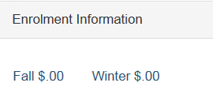
Student Information: Adding Semesters
In the student record, click on the top tool bar. For students who received funding, enter the details for each semester they were funded. The semester tabs displayed are the semesters the student received funding in the previous fiscal year.
From the Semester drop down list, select a semester during which the student was accepted into a program of study and was eligible to receive PSE funding. You can add up to four semesters – Spring, Summer, Fall and Winter.
Note: The Semester selected becomes part of the label to identify the Enrolment Information and Student Achievement Information sections.
Tip: To remove a Semester, click on the button in the top toolbar. Select Yes to confirm. When you remove a semester, you also remove the related information.
Repeat these steps for each semester the student received PSE funding.

Slide 19
Student Information: Adding Semesters
Important: If a semester bridges 2 fiscal years, the full semester is to be reported on in the fiscal year in which the semester began. For example, if a student attends a PSE Institution during a winter semester that runs from January 2017 to April 30, 2017, the funding for the month of April is to be included in the 2016-2017 PSE Report.

Slide 20
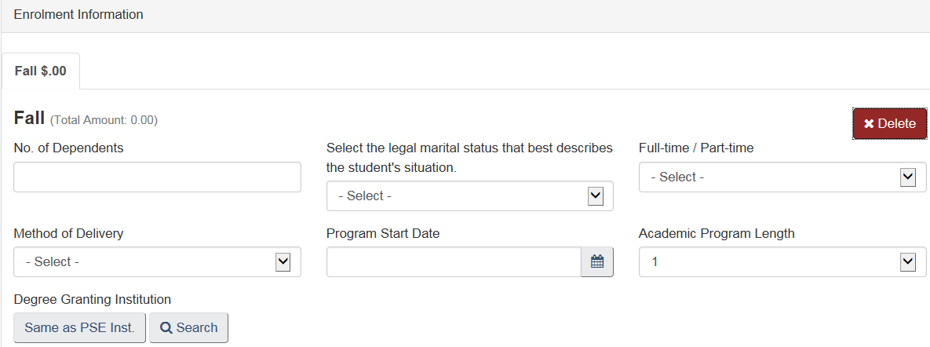
Student Information: Enrolment Information
Enter the Number of Dependents [if there are no dependents, enter 0 (zero)], Marital Status, Method of Delivery, Program Start Date, and the Academic Program Length (normal length of time required to complete the program on a continuing full-time basis; not necessarily the actual time).
If the Degree Granting Institution is the same one in which the student is enrolled, select the Same as PSE Institution button. If it is a different institution, search for its official name. If the institution is not on this list, contact your Regional Office.

Slide 21
Student Information: Enrolment Information
Select the Level of Education Sought (this list only contains credentials that are eligible for PSE funding).
Select the Area of Study – Category and the Area of Study – Sub-category.
This list is populated with relevant specializations based on the selected category. For details on the available categories, refer to the PSE – Areas of Study Job Aid.
Note: If the Level of Education Sought selected is University / College Entrance Preparation, the Area of Study – Category and Area of Study – Sub-category data fields are automatically populated.

Slide 22
Student Information: Student Achievement Information
Provide the corresponding Student Achievement Information to describe the results of the semester funded. These data fields are only available for students who were funded. For each semester:
Select the Student Achievement status at the end of the semester.
Select the Student's Academic Year of Study Just Completed.
Note: After you enter information in the first semester, the enrolment information is copied to subsequent semesters as you add them. You can change this information as required.

Slide 23
Student Information: Student Achievement Information
Note: The value entered in the Student's Academic Year of Study Just Completed data field is incremented once the year has been successfully completed. Until a student completes all the requirements for the first year of the program, select 0 (zero).
When the student completes all first year requirements, select 1 (one), after completing second year courses, select 2, and so on.
For example: A program requires that 5 courses be completed between September and April. If all 5 courses are completed, you would enter 1. However, if only 3 courses were completed, 0 would be entered.

Slide 24
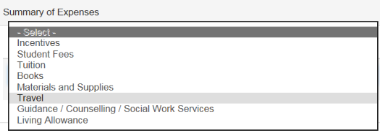
Student Information: Funds Provided by Type of Expense
Click to add an expense row for each type of expense, per semester, for which the student received funding.
Select an Expense Type.
Enter the sum of all the Funds Provided for this expense type.
Tip: To remove an Expense Type, click on the and select Yes to confirm.

Slide 25
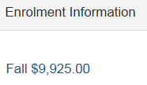
Student Information: Funds Provided by Type of Expense
The Total Amount is automatically calculated and is displayed in the semester tab.
Note: Although a PSE Report containing no expenses can be uploaded into EIS by an INAC employee, the Report cannot be accepted. Expenses must be entered in order for a Recipient to submit the Report via the Portal.

Slide 26
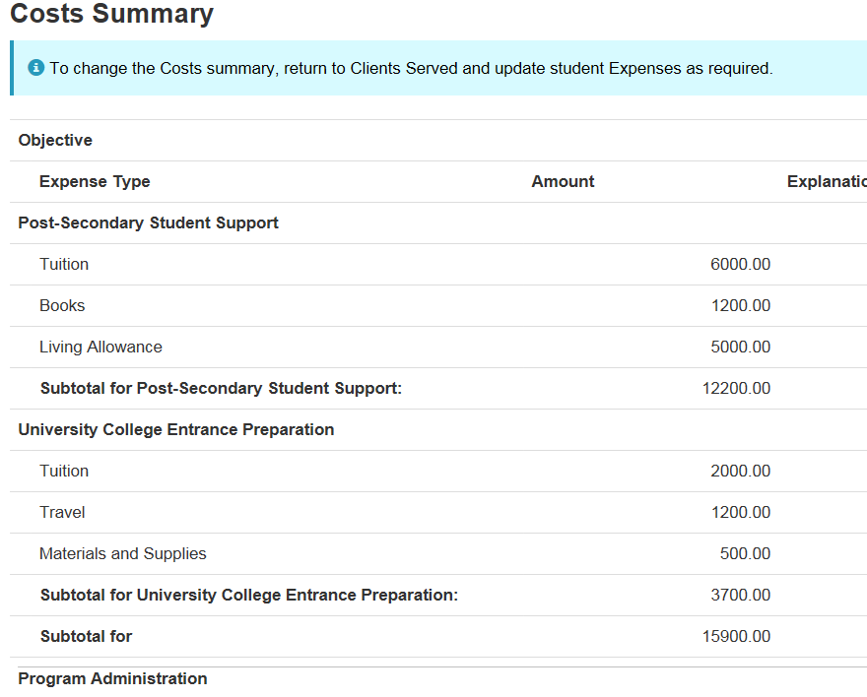
Costs Summary
The Expense Types are grouped into the following sections in the Cost Summary on the chevron:
University College Entrance Preparation (UCEP)
Post-Secondary Student Support (PSSSP)
Program Administration (for both UCEP and PSSSP)

Slide 27
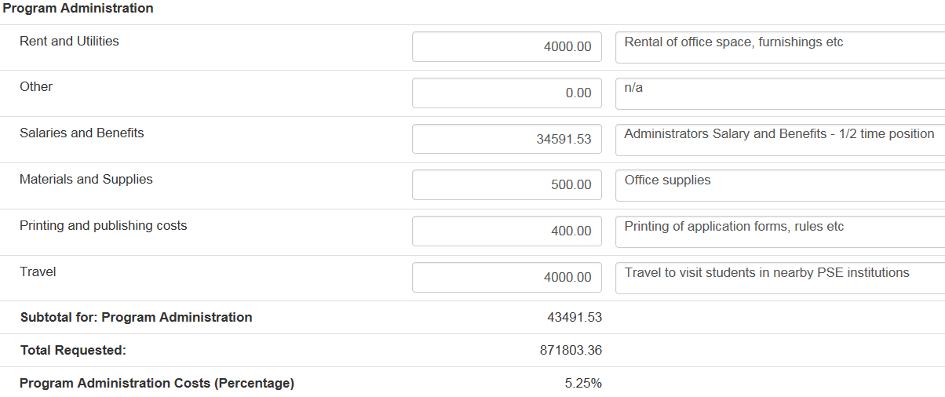
Costs Summary
Enter the Program Administration costs for each category and provide an Explanation.
Tip: Administration costs can be any value (including $0.00) up to 10% of the total program costs. The percentage of the Program Administration Costs is automatically calculated. When validated, a warning will be displayed if the value is exceeded.

Slide 28
Supporting Documents (optional)
Click on the tab on the Services Menu.
To attach a supporting document click the button and complete the data fields as required.
Important: There are no mandatory supporting documents required for the PSE Report. However, if you do submit them, all supporting documents MUST be submitted electronically.
Tip: To remove a Supporting Document, and the entire row from the list, click on the and select Yes to confirm.

Slide 29
Validate the Report
Click on the chevron and click .
After validating, errors or warnings are indicated.
Errors: Require action before a Report can be finalized.
Level 0 Warnings: Act as flags to Regional Offices and Recipients, but do not prevent the Report from being finalized.
Notes:
Click Validate to generate the Errors and Warnings
You will be warned that this action can take some time to complete. Click OK to proceed with the Validation.

Slide 30
Validate the Report
The Message Count lists the number of errors or warnings.
If the Report has no errors, click on the button and then click . . Skip to slide 33.
If the Report has errors, there are two features you can use to review and/or fix them:
Click on the Errors and Warnings tab to see the sections where they occur and to navigate to an error/warning to fix it
Click on the Assisted E/W Navigation tab to have the system navigate through the errors/warnings one by one
Notes:
If there are errors in the Proposal-Based Report you will be able to view them using this tab. You will be able to Print an Errors and Warning Report or view the errors in a hierarchal structure.

Slide 31
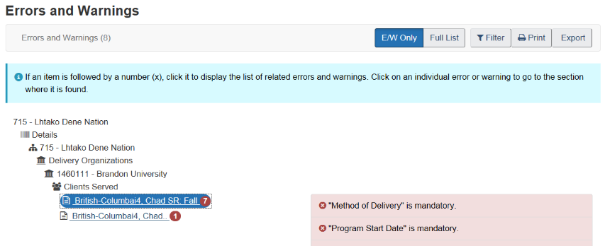
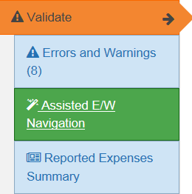
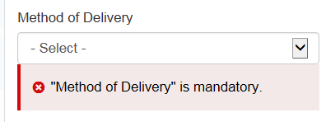
Validate Report: Errors and Warnings Tab
Click on the tab and the Errors and Warnings Report is displayed in a window.
Click on a red circle (error) or gold circle (warning) and a description is displayed.
Click on a description and the system moves you to the field where the error occurred to enter data.
Click to print the list of errors.
Click to view the sections of the form and where they occur. Click to list only the sections where errors occur.

Slide 32
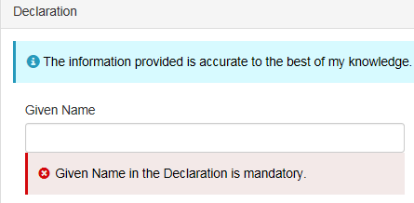
Validate Report: Assisted E/W Navigation Tab
Click on the tab to go through the errors/warnings one by one (in order)
Click on the button.
Review the information and make updates, as required. They are identified by a and a short description.
Click to move forward through the errors or warnings or click to move back to a previous one.
Once they have been resolved, click .
Click .

Slide 33
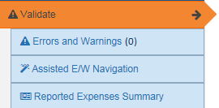
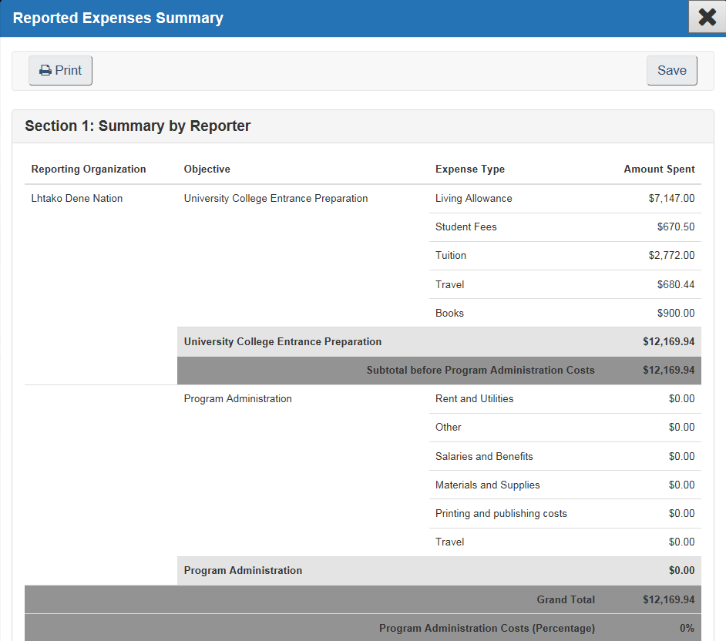
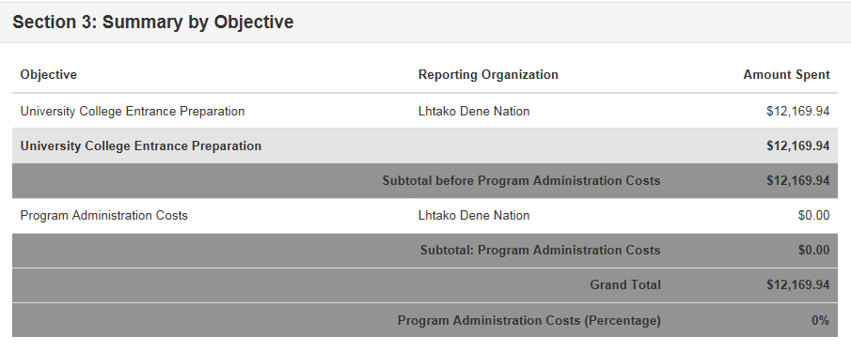
Reported Expenses Summary
To view the summaries:
Click on Reported Expenses Summary tab.
Scroll down to see Section 2 & 3.
Click on the Print or Save buttons.
Click on the to close.
Note: These are helpful summaries providing the ‘big picture’ . There is a Summary by Reporting Organization, Rolled Up Totals and a Summary by Objective.

Slide 34
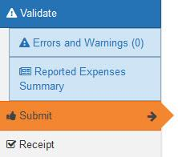
Submit the Report
Following successful validation of the Report, the Errors and Warnings summary will indicate there are no longer any errors
Click on the Submit chevron
Click the button.

Slide 35
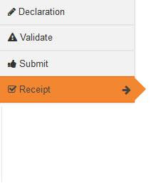
Confirmation and Status
On the Receipt chevron, a confirmation message is displayed.
A new Status will appear next to the Report on the Recipient Report Status screen.

Slide 36
Questions?

