Slide 1
First Nations Jurisdiction Over Education
Introduction and Overview to Education Jurisdiction

Slide 2
Suggested Procedure for Discussion and Questions
After each section there will be an allotted time for questions and discussion.
If questions come up during the slides, please record them in the Zoom chat and they will be collected by the discussion moderators.

Slide 3
Presentation Overview
Background and Context
What is jurisdiction over education?
Which First Nations is jurisdiction for?
How to support the exercise of Jurisdiction?
Foundations of the Jurisdiction Initiative and timeline
What’s in the nine key Education Jurisdiction Agreements?
Implementing jurisdiction over education
Overview of process to become a Participating First Nation

Slide 4
Background and Context
4

Slide 5
Current Legislation and Policy Supporting Schools
Since First Nations’ ability to operate their schools is currently subject to federal policies, this makes them vulnerable to political change.
The Education Jurisdiction Initiative refers to the collective work amongst First Nations in BC, the First Nations Education Authority (FNEA), the First Nations Education Steering Committee (FNESC), Canada and BC to support First Nations’ exercise of law-making authority (jurisdiction) over their education on First Nations land.
The jurisdiction initiative involves the creation of processes and mechanisms, through legislation and a suite of agreements, that enable the exercise of jurisdiction over education.
The key foundation for the jurisdiction initiative is the Canada – First Nation Education Jurisdiction Agreement, which is a Sectoral Self-government Agreement between individual Participating First Nations (PFNs) and Canada.
Notes:
FNESC is a First Nation education advocacy body that supports all BC First Nations on education related matters.
FNEA is a regulatory body that also provides support to First Nations exercising jurisdiction over education.

Slide 6
What is Jurisdiction over education?
Under the jurisdiction initiative, PFNs have law making authority over their Kindergarten for 4-year olds to Grade 12 school(s) (K4-12) located on their reserve land.
The education laws passed by PFNs are recognized by Canada and BC and provide PFNs with a measure of protection from potential changes to federal policies and legislation.
Notes:
Second bullet note: (e.g. the proposed 2012 First Nations Education Act). At the same time, they would also be able to benefit from positive advancements made available (e.g. UNDRIP, progress in Language and Culture Policies).

Slide 7
What does School Governance look like under Jurisdiction?
Under jurisdiction, PFNs can rely on Chief and Council to oversee the school or establish a separate governing authority (e.g., a Community Education Authority (CEA) or a school board) for that purpose.
The First Nation’s education laws and governance structure provide the framework for how jurisdiction will be implemented, including the operation of their schools.

Slide 8
Which First Nations is jurisdiction for?
Only First Nations who meet the following criteria will be able to exercise jurisdiction over education on their land under this initiative:
The First Nation must have a First Nations school on its reserve land;
the school must have classes for grades K4-12, or a mix of these grades.

Slide 9
Who is jurisdiction for? – Unique Situations
There are some situations where other First Nations send their students to a PFN school, but jurisdiction is exercised by the First Nation whose land the school is built on.
As more First Nations become interested in the jurisdiction initiative, other unique situations are emerging, which require further discussions and customized solutions.
One of these unique situations is schools used by an aggregate of First Nations, who would all like to participate in the jurisdiction initiative as one.
Jurisdiction can only be exercised by the First Nation whose reserve land the school is built on.
A solution to this problem would be to create CEAs, or schoolboards, comprised of the First Nations whose students attend the school. This would help ensure everyone is included in decision-making.

Slide 10
Who is jurisdiction for? – Independent Schools Considerations
Note: Under the provincial Independent School Act, schools operated by PFNs or their CEAs will not be able to retain their status as, or apply to become, “independent schools” under the Independent School Act.
This means that when First Nations choose to become PFNs, they will no longer be Independent Schools and First Nations should consider the implications of this decision.
FNESC is able to support First Nations who are prepared to give up their independent school status and become part of the jurisdiction initiative through the transition process.

Slide 11
How to support the exercise of jurisdiction?
First Nations wishing to exercise education jurisdiction should do the following internal work within their Nation:
determine what jurisdiction looks like to your First Nation;
conduct community outreach and meetings;
complete internal review of model agreements; and
complete review of support resources.
First Nations will need to internally decide if jurisdiction is the right path forward. FNESC will be there to provide continued support to any First Nation who wishes to pursue education jurisdiction.

Slide 12
Foundations of the Jurisdiction Initiative and Timeline
12

Slide 13
History
First Nations in BC have been working to have jurisdiction over their education recognized by Canada and BC for over two decades. The first milestone was reached when Canada, BC and FNESC signed a Memorandum of Understanding in 2003.
A number of agreements have been signed over the years, along with the passing of federal and provincial enabling legislation.

Slide 14
Signing of Jurisdiction Agreement
In May 2022, Canada and four First Nations signed individual Canada-First Nation Education Jurisdiction Agreements (Jurisdiction Agreements).
These agreements came into effect on July 1, 2022 and the four First Nations officially became PFNs:
ʔaq’am
Cowichan Tribes
Lil’wat Nation
Seabird Island
The First Nations Education Authority (FNEA) also came into full operation on July 1, 2022 and will be discussed further in this presentation.

Slide 15
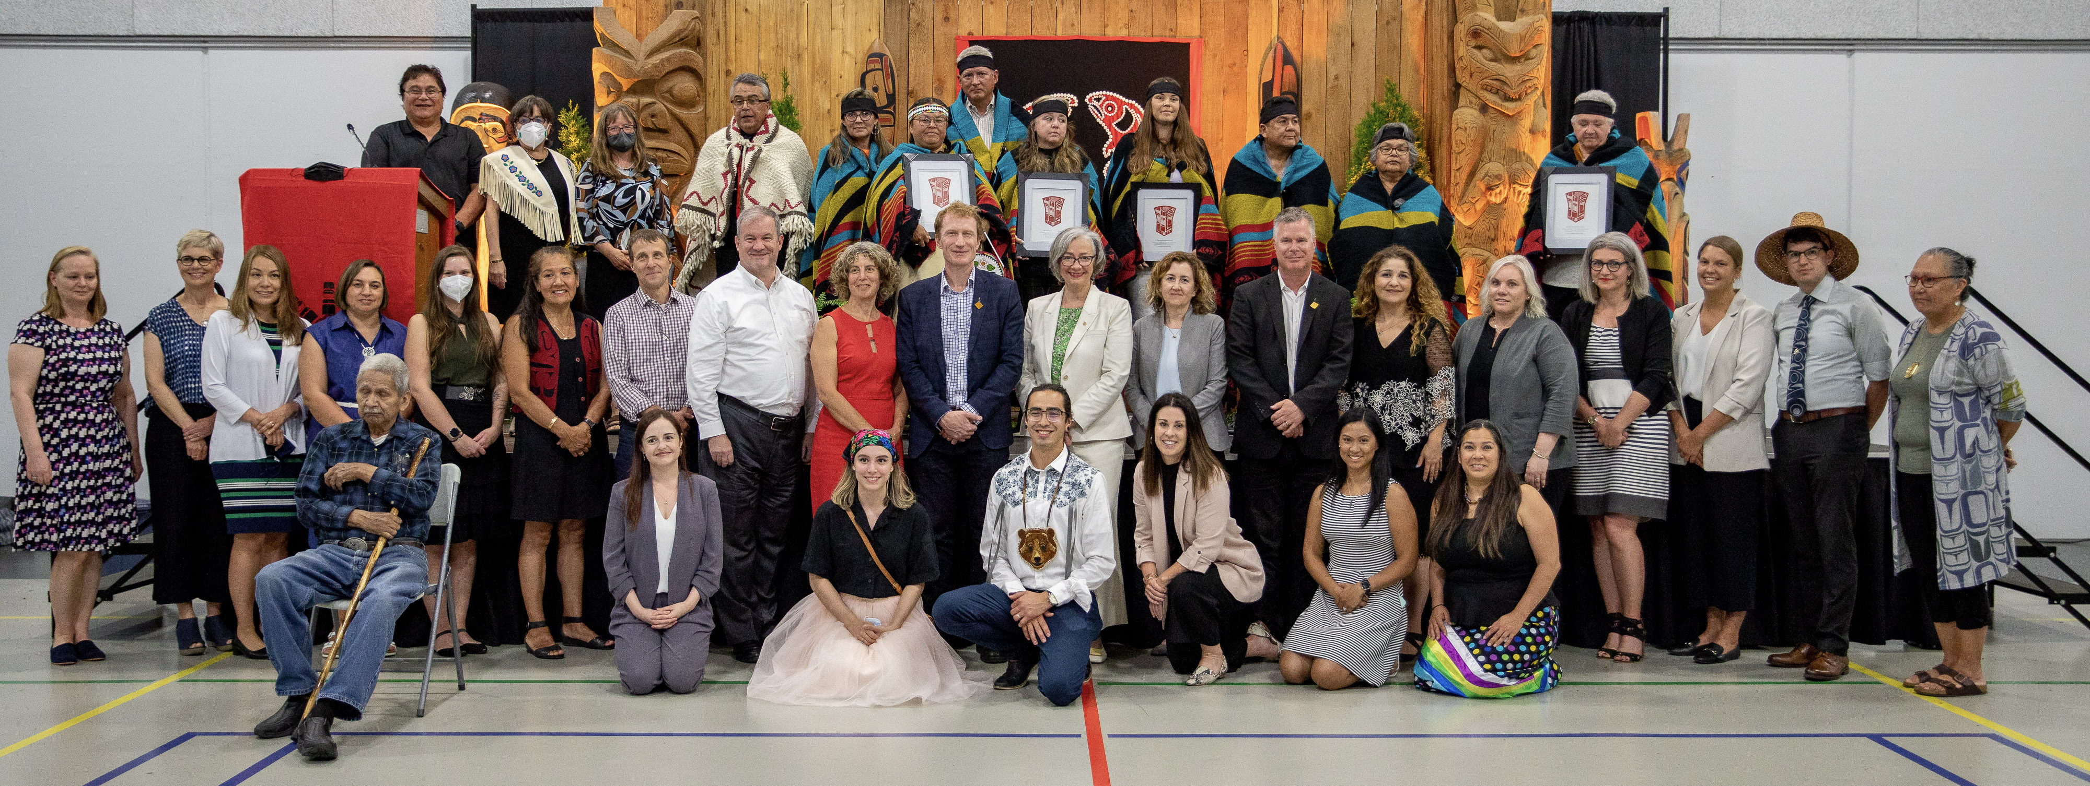
Jurisdiction celebration event at Seabird Island, July 11, 2022

Slide 16
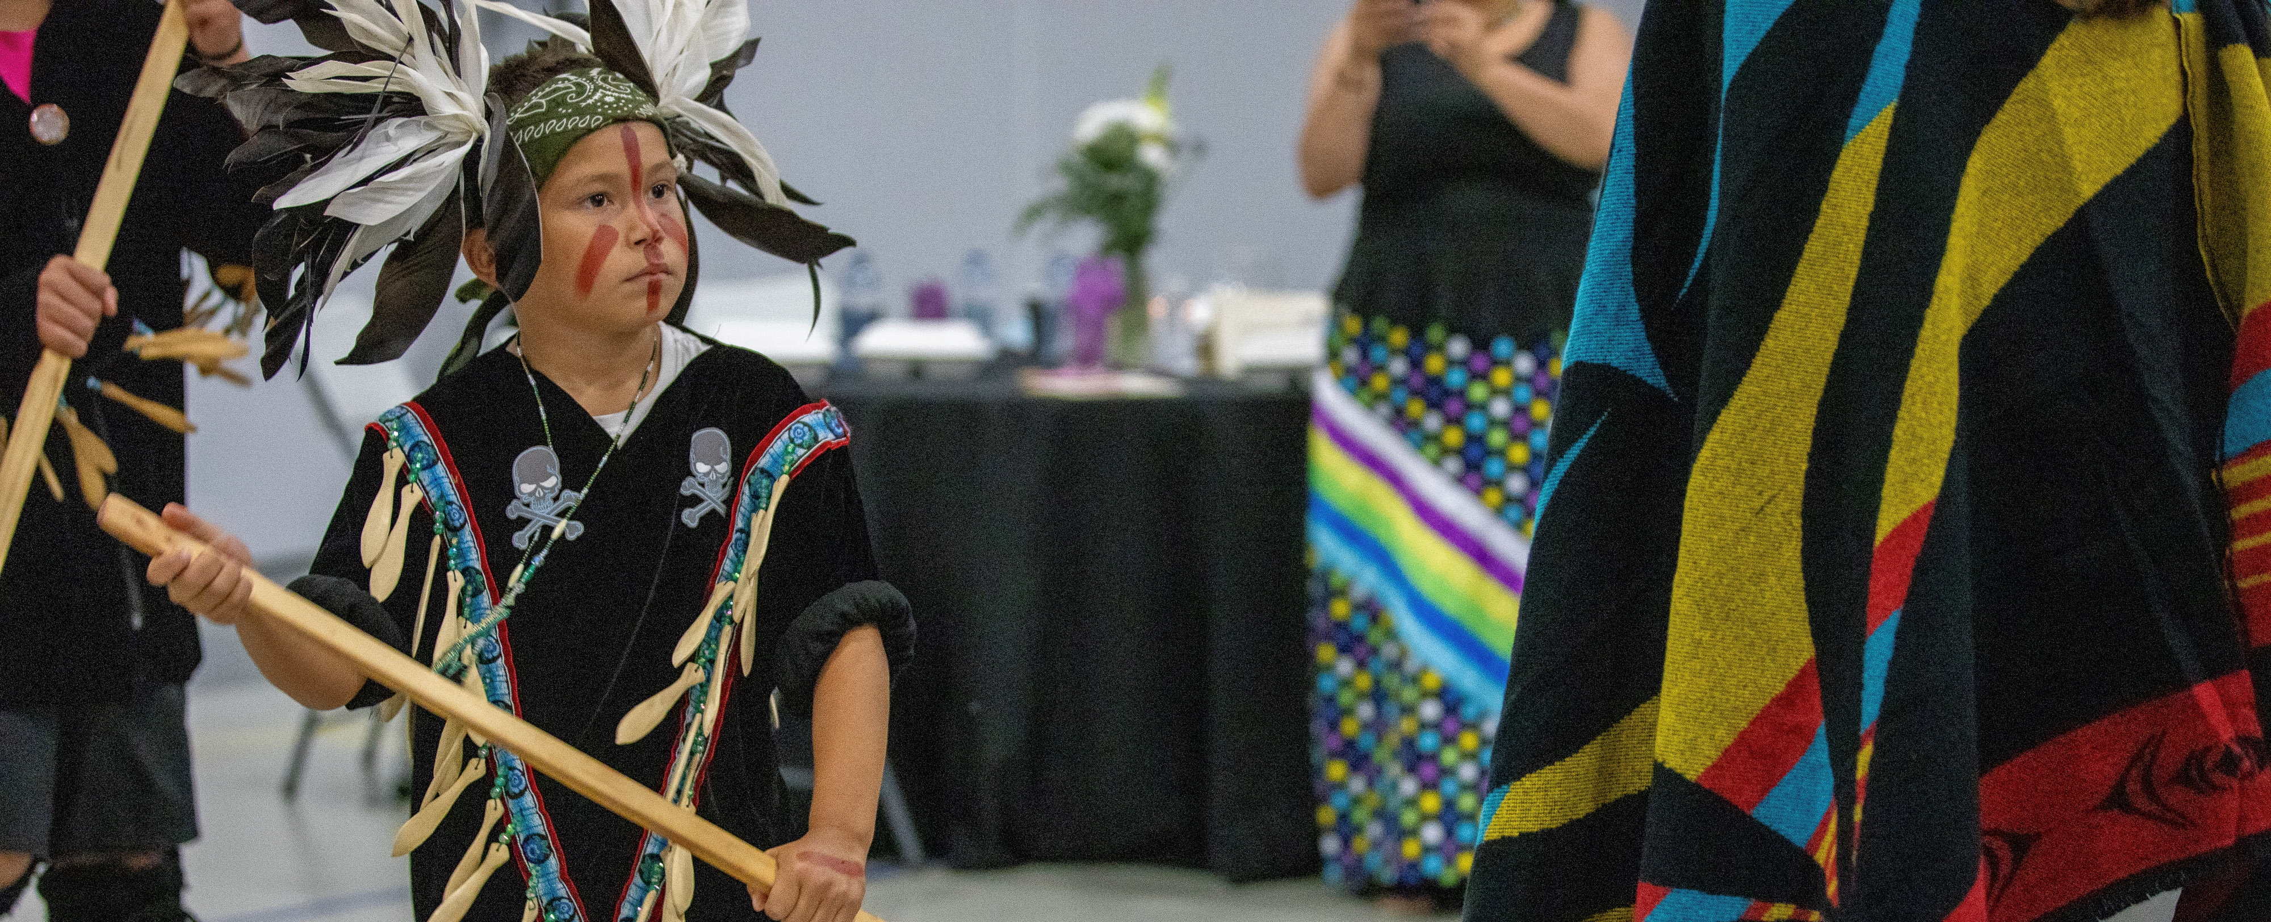
Sts'ailes Sasquatch Dancers at the jurisdiction celebration event

Slide 17
Additional Participating First Nations
In addition to the first four PFNs, three more First Nations have successfully completed the ratification process and became PFNs on July 1, 2023:
Canim Lake Band;
Ditidaht First Nation; and
Sḵwx̱wú7mesh Úxwumixw (Squamish Nation).
Other First Nations have expressed interest and the number of PFNs will likely increase in the years to come. FNESC will continue to support the onboarding of prospective PFNs.

Slide 18
Why is BCTEA Important to Jurisdiction?
The British Columbia Tripartite Education Agreement (BCTEA) is a tripartite agreement that sets out funding for First Nations education in BC.
BCTEA sets out important commitments for Canada, BC, FNESC and First Nations.
BCTEA sets the funding formula as well as programs and services for First Nations schools, including those in jurisdiction.
BCTEA is a time-limited agreement set to expire in 2025.

Slide 19
What’s in the nine key Education Jurisdiction Agreements?
19

Slide 20
20
Nine Key Education Jurisdiction Agreements
Agreements with Canada
Agreements with FNESC
These supporting statutes were passed after the 2006 Framework Agreement was signed
First Nations Education Jurisdiction Framework Agreement (2023 Replacement)
FNESC-FN Agreement
(In Development)
First Nations Jurisdiction Over Education in BC Act (Canada, 2006)
This Framework Agreement has two schedules:
FNESC-FNEA Agreement
Canada - First Nation Education Jurisdiction Agreement
Canada - First Nation Education Jurisdiction Funding Agreement
Agreements with FNEA
First Nations Education Act
(BC, 2007)
Education Co-Management Agreement (FNEA-PFN)
Agreements with BC
BC - FNESC Agreement
BC – FNEA Agreement
BC - PFN Agreement

Slide 21
Implementing Jurisdiction Over Education

Slide 22
Funding Under Jurisdiction
Under jurisdiction, PFNs will continue to receive the same funding and support currently available to other First Nations in BC for K4-12 education, which includes:
Direct First Nations School funding, including school staff salaries, which is calculated using the BCTEA methodology;
Additional support from FNESC (known as Second and Third Level Services) including language and culture and Special Education Programing; and
Any other funding or support that is available to other First Nations now or in the future.

Slide 23
New Jurisdiction Funding – Ratification and Governance
First Nations will receive funding to support ratification.
They will also receive one-time implementation and on-going Governance Funding to support the implementation of jurisdiction and their new governance responsibilities.

Slide 24
Exercising Jurisdiction
PFNs will have law making authority over their K4 -12 education in their First Nations Schools.
Key areas of jurisdiction have been collaboratively developed by First Nations, and will be jointly exercised and regulated by PFNs through FNEA. These areas are:
Certification and Regulation of Teachers
Certification of PFN Schools
Graduation Certificates and Courses Required to Graduate
Notes:
Jurisdiction would give a First Nation more control and security over their curriculum choices. They would have the ability to create complete language immersion schools, or have extensive culture and history components, and/or make these mandatory for graduation. Although the BC curriculum currently allows for a great deal of flexibility to include First Nations content in courses – there is no guarantee this policy approach will continue. Jurisdiction would ensure that a First Nations maintains this ability.

Slide 25
Teacher Certification Under Jurisdiction
Outside the jurisdiction initiative, teachers in First Nation schools are required to have a teaching certificate from BC or another province or territory or other authorization from BC (e.g. letter of permission).
Under the jurisdiction initiative, in addition to being able to hire teachers with provincial and territorial certificates or other authorizations, PFN schools will also be able to hire teachers certified with a FNEA Teaching Certificate (FTC).
The FTC requirements are established and regulated by FNEA.
Qualified individuals can apply for a FTC only with the support of a PFN school.

Slide 26
Other Areas over which Jurisdiction can be exercised
Jurisdiction allows for First Nations to transform policies, pertaining to education and their schools, into law. The policies that can be transformed into law under jurisdiction include:
Language and culture curriculum, and “on the land” learning
School calendar, length of school days, and hours per year
Discipline policy for students
Elder and traditional knowledge keeper compensation
Conflict of interest and code of conduct for staff and the school authority
Management of school facilities and operations
Note: not all policies must become laws, there are model law resources available to help First Nations create their own education laws.

Slide 27
Overview of Process to become a Participating First Nation

Slide 28
Process to become a PFN
Pass a BCR to become an IFN
Interested First Nations (IFN):
Has formally expressed an interest in the education jurisdiction initiative through a First Nation resolution.
If IFN submits second BCR to Canada
Committed First Nations (CFN):
Has received or formally requested an offer from Canada respecting a Canada-First Nation Education Jurisdiction Agreement.
When a CFN accepts an offer
Accepted Offer First Nations (AOFN):
Has accepted an offer from Canada, but has not yet completed the ratification process.
When AOFN ratification vote is successful
Ratified First Nations (RFN):
Has successfully ratified a Canada-First Nation Education Jurisdiction Agreement and law-making protocol.
When OIC comes into effect (after RFN has signed Agreement)
Participating First Nations (PFN):
Their name has been added to the schedule of the Federal Act by an Order in Council.

Slide 29
Appointing a Jurisdiction Lead
If an IFN decides to pursue jurisdiction, one of the requirements to become a CFN, is to select a jurisdiction lead. This position should be selected with special consideration given to the scope of work, timeline and extensive time commitment required. Some of the responsibilities of the jurisdiction lead include:
being the contact for your Nation that Canada, BC, FNEA and FNESC will engage with;
overseeing and guiding your First Nation through the jurisdiction process;
reading and understanding all of the jurisdiction agreements and other critical documents;
attending meetings;
disseminating relevant information to community and leadership; and
possibly supporting the ratification process.
It is recommended that a Nation identify an individual who works closely with the community and who can stay in the position for at least a year. Having experience with education and/or having a technical background would be an asset.

Slide 30
Important Dates and Timing Considerations
For First Nations Without an Offer:
It is likely to take about one year for Canada to prepare an offer for a First Nation that has requested an offer.
For First Nations With an Offer:
November 15th (for July 1 effective date of the following year):
Deadline for Canada to initiate Order in Council request.
Ratification workplan must be available.
December 31: Ratification results must be available by this date (for July 1 effective date of the following year).
For Ratified First Nations:
OIC generally approved in June for July 1 effective date.

Slide 31
Glossary and Acronyms
Accepted Offer First Nations (AOFNs): means a First Nation that has received and accepted an offer from Canada respecting a Canada-First Nation Education Jurisdiction Agreement, but not yet ratified the agreement;
Committed First Nations (CFNs): means a First Nation that has received a current offer or formally requested an offer from Canada respecting a Canada-First Nation Education Jurisdiction Agreement;
Engaged First Nations: means the IFNs, CFNs, AOFNs, and RFNs;
Interested First Nations (IFNs): means a First Nation whose Band Council has passed a band council resolution or provided a letter on the First Nation’s letterhead indicating their interest in exercising jurisdiction over education;
Participating First Nations (PFNs): means a First Nation whose individual Canada-First Nation Education Jurisdiction Agreement has come into force; and
Ratified First Nations (RFNs): means a First Nation that has successfully ratified a Canada-First Nation Education Jurisdiction Agreement and law-making protocol.

Slide 32
Education Jurisdiction Resources
Web Resources (jurisdiction videos, template BCRs and letters, checklist, etc.)
Jurisdiction Webpage: http://www.fnesc.ca/about-fnesc/jurisdiction
A jurisdiction video file is also available online and is a great resource to provide a historical overview.
Jurisdiction Toolkit (under development)

Slide 33
Discussion and Questions?
33

Slide 34
Thank You
If you have any further questions, please contact:
Jenna MacIver, Coordinator, Executive Services and Jurisdiction Preparation
First Nations Education Steering Committee
Suite 113 – 100 Park Royal South
West Vancouver, BC V7T 1A2
Email: jennam@fnesc.ca
Phone: 604-925-6087 ext. 163
Fax: 604-925-6097

