Slide 1

Annual Meeting on Transportation to Public Schools
BC Tripartite Education Agreement (BCTEA):
Supporting First Nation Student Success
March 4, 2025 - 10:00 am -12:00 pm

Slide 2
Recognition of the Territory

Slide 3
Meeting Overview
Context
Funding available for transportation-related costs
Policy changes for 2025/2026
  Requests for Extracurricular Funding
  Status Quo Letter
2025/2026 Joint First Nation Student Transportation Plan submissions
2024/2025 Reporting
Questions and Closing Remarks

Slide 4
Meeting Procedures and Resources
Each participant received a Zoom participant guide and meeting material
Please display your full name and First Nation or school district number while participating in the meeting
Your microphone will be muted automatically to minimize background noise
We encourage questions at the end of each section of the presentation via the “Chat” function or, if you wish to ask your question verbally during the Q&A period, please use the “Raise Hand” function under Reactions and, if possible, turn on your camera (refer to the Zoom Participant Guide for more details)

Slide 5
Context

Slide 6
Number of Learners
Slight increase in Indigenous learners on-reserve from last year (.66%).
 | All Indigenous | Indigenous On-Reserve | Indigenous Off-Reserve
2019/20 | 75,655 | 8,209 | 67,446
2020/21 | 73,750 | 7,754 | 65,996
2021/22 | 74,654 | 7,992 | 66,662
2022/23 | 73,858 | 8,074 | 65,784
2023/24 | 72,515 | 8,127 | 64,388

Slide 7
Five-Year Completion Rate

Slide 8
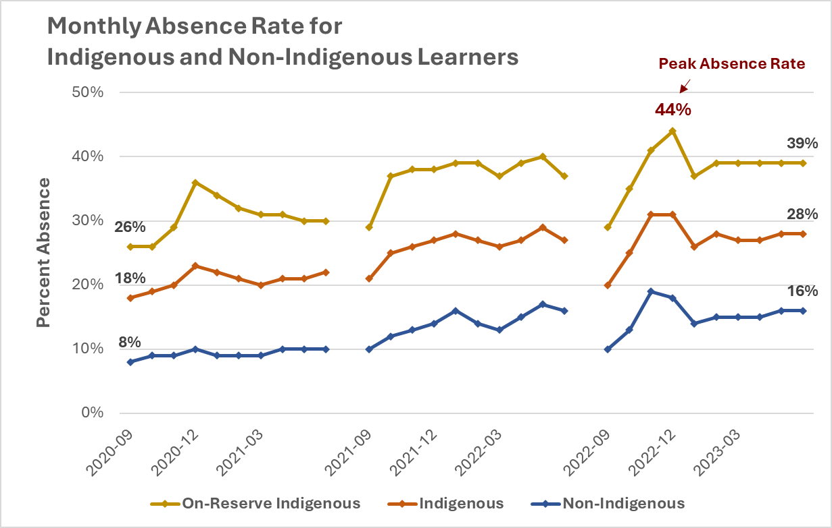
Student Absence Rates

Slide 9
BC Tripartite Education Agreement (BCTEA)
Schedule G - Transportation
BCTEA, a five-year agreement that replaces the previous Tripartite Education Framework Agreement (TEFA, 2012-2018) was given a two-year extension to 2025 supported by the FNESC Board, the FNSA Board, the First Nations Leadership Council, Indigenous Services Canada and the Ministry of Education and Child Care
In Schedule G, the BCTEA Parties committed to developing and implementing effective measures to address existing and future issues arising from the transportation of First Nation students living on reserve to BC public schools
In addition to existing funds, the Parties established a First Nation Student Transportation Fund that BC would receive from Canada and allocate to school districts by way of special purpose grant pursuant to Section 115 of the School Act

Slide 10
BC Tripartite Education Agreement (BCTEA)
Schedule G – Transportation, cont’d
A tripartite First Nation Student Transportation Committee was established to review the Joint First Nation Student Transportation Plans (“Joint Plans”), develop policies and procedures for the administration of the Fund, and review the overall effectiveness of the strategy and of its implementation
Boards of education and First Nations have been encouraged to establish and maintain a collaborative process to develop Joint Plans, informed by guiding principles and criteria established by the BCTEA Parties

Slide 11
Guiding Principles for Developing Joint
First Nation Student Transportation Plans
The Board of Education and First Nation identify transportation needs of students enrolled in BC public schools, respecting parental choice
Safety is paramount in all planning and decisions
Transportation is available for extracurricular activities and sports/sporting events
There are no walk limits
The shortest ride possible
Wherever possible, no highway pick-ups/drop-offs
Establish communications protocols
Drivers receive professional development
Criminal record checks required
Changes to the joint plan through written agreement with timely notice to parents
Source: BCTEA-Guiding-Principles-for-Transportation.pdf

Slide 12







BCTEA First Nation Student Transportation
In 2024/25,
Joint Plan approvals for To/From totalled over $4M million
A total of $1M was allocated for Extracurricular
2023/24 reported
BCTEA funds spent on Extracurricular
Transportation:
$648,713
Every year approximately 160+ Joint Plans
co-developed & reviewed
Over 6,800 First Nation Students included in a BCTEA Joint Plan
Students transported approximately 10,500 kms to school

Slide 13
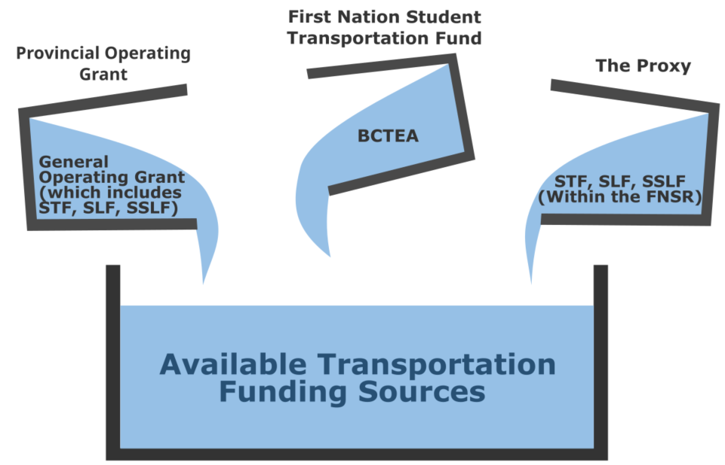
Available Transportation Funding Sources
FNSR Proxy
  Student Location Factor (SLF), Supplemental Student Location Factor (SSLF) and Student Transportation Fund (STF) included in the First Nation Student Rate (FNSR) is the Proxy for Transportation funding
  This is the minimum amount of FNSR funding that should be used for transportation of First Nations Students living on reserve
Provincial general operating grant funding
  Student Transportation Fund ($15.4M in 2024-2025), SLF, SSLF
BCTEA First Nation Student Transportation Fund by Canada ($3.8M)
  Intended to be supplemental to existing funding sources

Slide 14
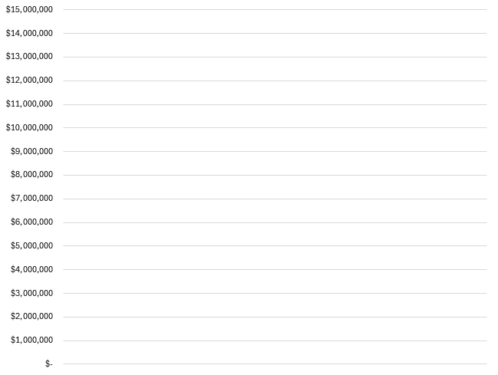
Total Spent on First Nation Student Transportation To/From School (2023/24)
BCTEA To/From and EX Carryover $1.14M (8%)
BCTEA (Federal)
$2.8M (19%)
The total spent on First Nation Student transportation To/From School was $14.745 million
School District amount above the Proxy (Provincial Operating Grant)
$5.8M (39%)
Source: Data as reported on Joint Plans and Revenue and Spending Reports
School Districts’ FNSR Proxy
(Federal)
$5M (34%)

Slide 15
BCTEA Transportation Funding -
Positive Feedback
“The bus supervisor position has helped to improve attendance rates… Attendance for this group has improved by 42% since the bus supervisor position has been in place.”
“This enabled students to avoid exposure to adverse weather conditions and excessive and unsafe walking distances to school along busy roads.”
“The express bus… has decreased the travel time by 50% for the students from 1.5 hours each way to 45 minutes each way.”
“… has made an impact on absence numbers for students in addition to providing a safer alternative for pick-up and drop-off.”
There is one language speaker at the school. [Extracurricular funding] allows us to bus students from other schools in for this program, so they can also benefit from the language instruction.
Transportation to cultural land-based programs for students has improved attendance, engagement in learning and provided credits required for graduation.

Slide 16
Capital Funding for Buses
Funding for Bus Acquisition
Requests for buses are processed through the provincial application-based Bus Acquisition Program. This Program is for school district assets only and is restricted to “yellow fleet” buses (diesel and electric buses)
Budget 2024 announced $27 million in capital funding over three years to enable more school districts to buy electric school buses (increase in $9 million a year)

Slide 17
Questions?

Slide 18
2025/2026 Policy Updates

Slide 19
Extracurricular

Slide 20

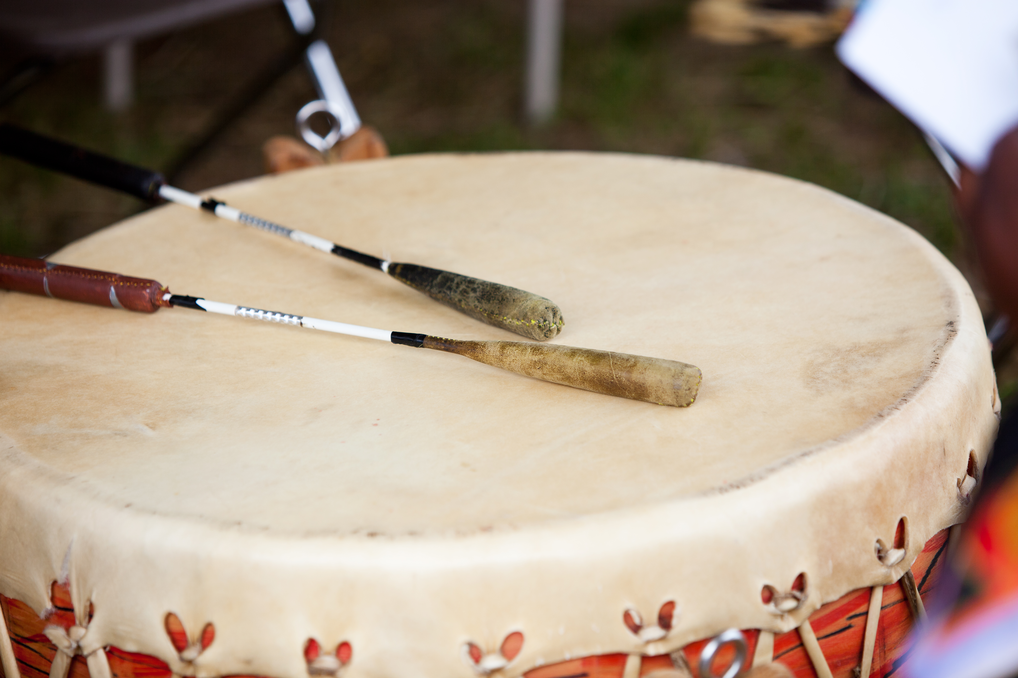

Transportation to Extracurricular Activities
The purpose of the funding is to assist First Nations Students’ transportation to school organized extracurricular activities and sports. Examples of eligible activities include:
  athletics, homework and music clubs and school-based cultural activities
School activities may be located off school property e.g., a different school gym or soccer field and/or be delivered by a private organization for cases where the school district works with an organization to deliver extracurricular activities

Slide 21
Extracurricular Allocation Change - Context
Cost of To/From school transportation has increased each year with the First Nation Student Transportation Fund unchanged
There is approximately $1.8M Extracurricular funds available in the sector, with average yearly spending of $650K
There are school districts with carryover that are unable to spend Extracurricular funds for a variety of reasons
Not all First Nations are aware of available Extracurricular funding
Students are participating in Extracurricular activities, where the transportation services may not be covered by BCTEA Extracurricular funds
In school districts that serve multiple First Nations, the funding needs may vary

Slide 22
Extracurricular Allocation Change – New this year!
Allocation process up to 2024/2025 school year
$1M in Extracurricular transportation is allocated proportionately as determined by Nominal Roll for each school district
New this year (2025/2026)
School districts will indicate on each Joint Transportation Plan or Status Quo Letter if Extracurricular funds are required for the 2025/2026 school year
Extracurricular funding may be requested for up to the allocation the school district received in 2024/25. This funding is not meant to cover full costs but rather to serve as a subsidy for extracurricular transportation
When a school district has Extracurricular carryover funds, and is requesting Extracurricular funding, they will be asked to use the carryover first. If the carryover is insufficient to fund the requested amount, then additional funds will be allocated

Slide 23
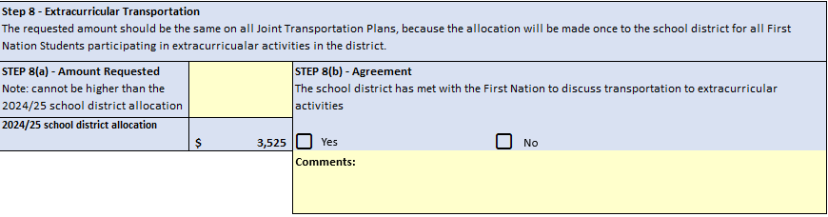
Extracurricular Allocation Change – New this year!

Slide 24
Status Quo Letter

Slide 25

Status Quo Letter – Updates
Introduced for the 2024/25 school year to streamline submission process
71 Status Quo Letters received
School districts and First Nations have the option of a Status Quo Letter if:
    the services have not changed from last year (i.e., the request includes the same schools on the same route);
    the request is for To/From School only (not applicable if you have Parental Assistance or Special Supports); and
    the total request does not exceed an increase of 8%.
    Note: The calculation increase should be on 2024/25 approved amounts, not on requested amounts.

Slide 26
Status Quo Letter – Additions
Pro-rating
  Indicate if BCTEA request is a pro-rated amount and describe calculation used for pro-rating services when students off-reserve are on the same bus. (e.g. cost of service divided by ridership or cost of service divided by distance)
Table for transportation costs
  Briefly describe the factors that drove the change in costs by category
Extracurricular
  Indicate the amount requested, up to the allocation received in 2024/25 as noted in the 2024/2025 Approval Letter

Slide 27
Questions?

Slide 28
2025/2026 Joint First Nation Student Transportation Plan Submissions

Slide 29
Options for Submitting Joint Plans
School districts and First Nations will be asked to co-develop and submit their plan for the 2025-2026 school year by May 16, 2025.
Joint Plan - categories include:
  New Joint Plan: Requests for funding are for new/additional services only, not for existing services
  Revision to Previous Joint Plan: when the plan submitted in 2024/2025 is not meeting the needs of the First Nation and needs revision. Includes a detailed description of First Nation Students’ current transportation needs
  Status Quo: when the Joint Plan submitted in 2024/2025 continues to meet the needs of the First Nation. This includes requests for special supports and parental assistance
Status Quo Letter: Separate template
Regardless of the category, co-development and agreement with respective First Nations is required.

Slide 30
Joint Plan - Updates
Cost of base service (Step 2b)
    Updated description to “School District’s financial contribution for Transportation Services in place for First Nation Students living on reserve that are not funded by BCTEA”
Pro-rating (Step 4)
    Indicate if BCTEA request is a pro-rated amount and describe calculation used for pro-rating services when students off-reserve are on the same bus. (e.g., cost of service divided by ridership or cost of service divided by distance)
First Nation Schools of Choice (Step 5)
    Indicate if route changes to include a new First Nation Schools of Choice

Slide 31
First Nation Schools of Choice –
Implementation Costs
Implementing the First Nation Schools of Choice will require the use of existing funding sources:
  Operating Grants
  Student Transportation Fund ($15.4M)
  Transportation Proxy (included in the First Nation Student Rate)
  BCTEA First Nation Student Transportation Fund ($3.8M)

Slide 32
Joint Plan - Updates
Funding Sources (Step 6)
    Pre-populated with the school district’s available 2024/25 funding sources
  Bus costs (Step 7)
    Table provided to breakdown cost of BCTEA funding request includes:
          Driver salary, benefits
          Bus maintenance, insurance
Extracurricular (Step 8)
    New process to request continued funding for transportation to Extracurricular activities

Slide 33
Parental Assistance – New Tab
Parental Assistance
  The number of vehicles
  The per km rate used to calculate request
  Number of school days required (if not every school day, please explain why)
  The extraordinary/unique circumstance for the Parental Assistance request including:
        Details on the services/programs offered including how they address the student's unique needs.
        How the request positively impacts student outcomes (expected/historical)
        Have other alternatives been considered? This includes modifying bus route or increasing support at current school

Slide 34
2025/2026 Joint Plan Submission Process
  The Ministry will provide last year’s (2024/25) approved Joint Plan to the school districts
  Unsigned or late Joint Plans may not be considered for supplemental funding
  Email confirmation of agreement of Joint Plan in lieu of signatures is acceptable
  Signature (or email) also implies that pick-up and drop-off points have been reviewed for safety considerations

Slide 35
2024/2025 Revenue and Spending Report

Slide 36
2024/2025 Revenue and Spending Report
The Revenue and Spending Report is intended to help First Nations and BCTEA Parties understand:
  Total cost of transportation for First Nation Students living on reserve attending public school
  Board spending on transportation, including the “Proxy“, for First Nation Students living on reserve attending BC public school
  The use of BCTEA funding for to/from school and extracurricular activities
  New this year: Simplified Extracurricular report

Slide 37
Questions?

Slide 38
Important Dates
April 1
Transportation Joint Plan Drop-in Session #1
April 29
Transportation Joint Plan Drop-in Session #2
May 16
2025/2026 Joint Plan submission deadline (joint sign off required)
Fall 2025
Approval letters sent out
September 30
School district financial statements due to the Ministry

Slide 39
Questions and Closing Remarks
For questions about First Nation Student Joint Transportation Plan requirements or related materials:
School districts may contact:
First Nations may contact:
Funding & Financial Accountability Ministry of Education and Child Care
BCTEA@gov.bc.ca
First Nations Education Steering Committee
BCTEA@fnesc.ca
Indigenous Services Canada
BC Education Mailbox
bceducation@sac-isc.gc.ca
OR

Slide 40
Thank you for your participation!
The BCTEA Parties request your feedback to understand how we can best share the most relevant information with you. A pop-up will appear after this session for you to fill out
Participation is voluntary, and responses are anonymous. If personal information is inadvertently provided, it will be deleted
Please email bctea@gov.bc.ca if you would you like to schedule a 1:1 meeting with BCTEA Parties

